Slide 1
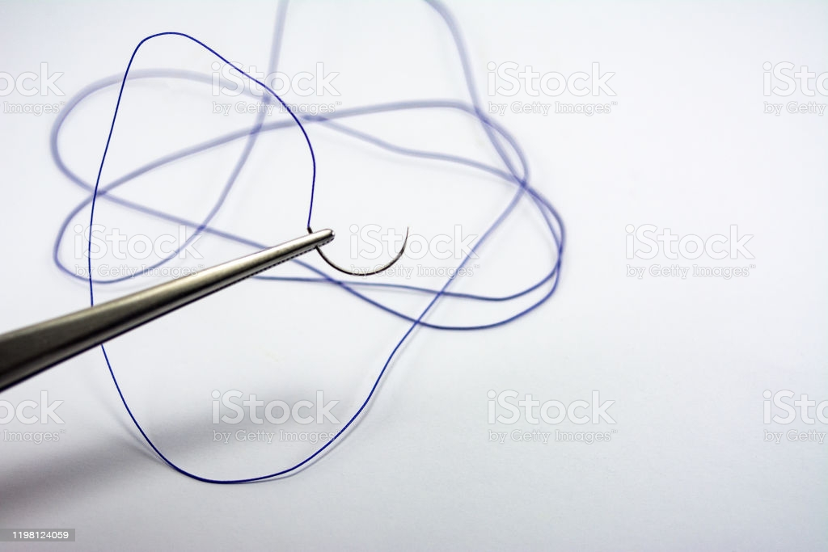
أنواع الخيوط الجراحية

Slide 2
Specific Suturing Materials
Suture materials may be classified according to
their behavior in tissue (absorbable or nonabsorbable),
their structure (monofilament or multifilament),
their origin (synthetic, organic, or metallic)

Slide 4
Two major mechanisms of absorption result in the degradation of absorbable sutures.
Sutures of organic origin, such as surgical gut, are gradually digested by tissue enzymes and phagocytized,
sutures manufactured from synthetic polymers are principally broken down by hydrolysis.
Nonabsorbable sutures are ultimately encapsulated or walled off by fibrous tissue.

Slide 5
Monofilament sutures are made of a single strand of material and therefore have less tissue drag than multifilament sutures and do not have interstices that may harbor bacteria or fluid.
Care should be used in handling monofilament suture because damaging the material with forceps or needle holders may weaken the suture and predispose it to breakage.
Multifilament sutures consist of several strands of suture that are twisted or braided together. Multifilament sutures generally are more pliable and flexible than monofilament sutures. They may be coated to reduce tissue drag and enhance handling characteristics.

Slide 6
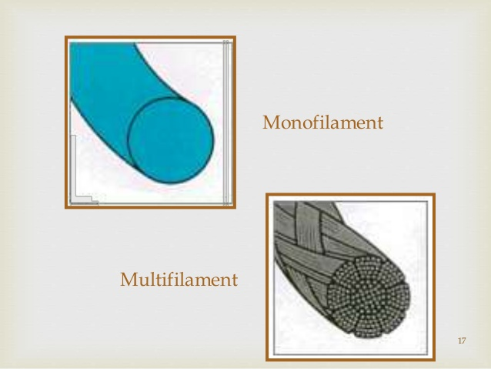

Slide 7
Absorbable Suture Materials
Absorbable suture materials (e.g., surgical gut, polyglycolic acid [Dexon, Covidien, Mansfield, Mass.], polyglactin 910 [Vicryl, Ethicon, Somerville, N.J.], polydioxanone [PDS II, Ethicon, Somerville, N.J.], polyglyconate [Maxon, Covidien, Mansfield Mass.], poliglecaprone 25 [Monocryl, Ethicon, Somerville, N.J.], glycomer 631 [Biosyn, Covidien, Mansfield, Mass.])
lose most of their tensile strength within 60 days and eventually disappear from the tissue implantation site because they have been phagocytized or hydrolyzed.
The time to loss of strength and for complete absorption varies among suture materials.

Slide 8
Organic absorbable materials.
Catgut (surgical gut) is the most common nonsynthetic absorbable suture material.
Although once very popular, its use has decreased substantially in veterinary medicine with the appearance of strong monofilament synthetic absorbable suture materials.
The word catgut is derived from the term kitgut or kitstring (the string used on a kit, or fiddle).
Misinterpretation of the word kit as referring to a young cat led to the use of the term catgut.

Slide 9
Catgut (surgical gut)
Surgical gut is in fact made from the submucosa of sheep intestine or the serosa of bovine intestine and is approximately 90% collagen.
It is broken down by phagocytosis and, in contrast with other suture materials, results a notable inflammatory reaction.
Surgical gut is available as plain, medium chromic, or chromic; increased tanningالدباغة generally implies prolonged strength and reduced tissue reaction.
Surgical gut is rapidly removed from infected sites or areas where it is exposed to digestive. The knots may loosen when wet.

Slide 10
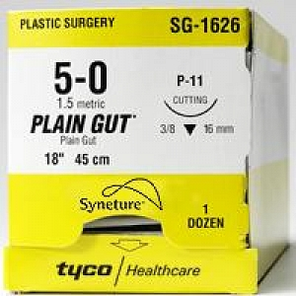
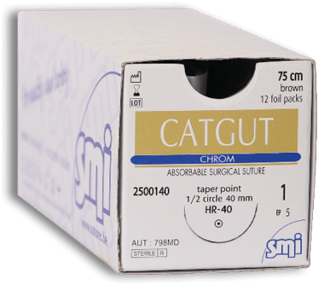

Slide 11
Synthetic absorbable materials.
Synthetic absorbable materials generally are broken down by hydrolysis and cause minimal tissue reaction.
The time to loss of strength and to absorption is fairly constant even in different tissue.
Infection or exposure to digestive enzymes does not significantly influence the rate of absorption of most synthetic absorbable sutures.
Polyglactin 910 and polyglycolic acid are more rapidly hydrolyzed in alkaline environments, but they are relatively stable in contaminated wounds.
However, any suture that is degraded via hydrolysis may be at risk for accelerated degradation when the bladder is infected with Proteus spp.

Slide 12
Monofilament absorbable materials.
Polydioxanone and polyglyconate are classic monofilament sutures that keep their tensile strength longer than multifilament sutures with complete absorption occurring in 6 months.
Poliglecaprone 25 and glycomer 631 are relatively new monofilament rapidly absorbable synthetic materials that are pliable, lack stiffness, and have good handling characteristics.
These sutures have good initial tensile strength that deteriorates in 2 to 3 weeks following implantation and are completely absorbed by 120 days.

Slide 13
Multifilament absorbable materials.
Polyglycolic acid is braided from filaments extracted from glycolic acid and is available in both coated and uncoated forms.
Polyglactin 910 is a multifilament suture made of a copolymer of lactide and glycolide with polyglactin 370. It is coated with calcium stearate and its rate of loss of tensile strength is similar to that of polyglycolic acid.
Polysorb is a new synthetic absorbable suture material composed of a glycolide/lactide co-polymer. Polysorb has good initial tensile strength and is completely absorbed by 60 days.
Vicryl Rapide is a relatively new, rapidly absorbed, synthetic braided suture that has an initial strength that is comparable to nylon and gut. However, the tensile strength declines to 50% in 5 to 6 days, and it is completely absorbed in 42 days. This suture is indicated for superficial closure of mucosa, gingival closure, and periocular skin closure.
Vicryl Plus is a new suture that was designed to reduce bacterial colonization on the suture. It has been coated with an antibacterial agent, triclosan.

Slide 14
Nonabsorbable Suture Materials
Organic nonabsorbable materials.
Silk is the most common organic nonabsorbable suture material used. It is a braided multifilament suture made by a special type of silkworm and is marketed as uncoated or coated. Silk has excellent handling characteristics and often is used in cardiovascular procedures;
It should also be avoided in contaminated sites; one silk suture may reduce the number of bacteria required to induce infection in a wound from 10 6 to 10 3.

Slide 15
Synthetic nonabsorbable materials.
Synthetic nonabsorbable suture materials are marketed as
1. braided multifilament threads (e.g., polyester or coated caprolactam) or
2. monofilament threads (e.g., polypropylene, olyamide, or polybutester).
These sutures are typically strong and induce minimal tissue reaction.

Slide 16
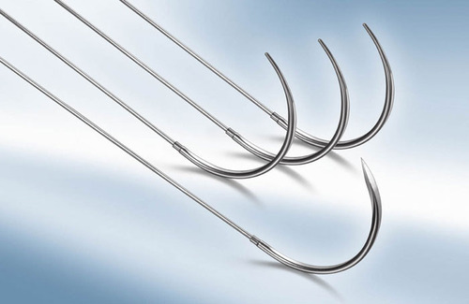
Metallic sutures.
Stainless steel is the metallic suture most commonly used and is available as a monofilament or multifilament twisted wire.
Surgical steel is strong with minimal tissue reaction, but knot ends evoke an inflammatory reaction. Stainless steel has a tendency to cut tissue.
It is stable in contaminated wounds and is the standard for judging knot security and tissue reaction to suture materials.

